Slide 1
GIF 动画情感分析技术
GIF 动画情感分析技术有着广泛的应用前景
GIF 动画情感分析任务充满了挑战
This work has been submitted to ACM’MM 2015 and is under peer review.

Slide 2
GIF 动画情感分析技术
GIF 动画情感分析技术有着广泛的应用前景
GIF 动画情感分析任务充满了挑战
在 286,517 微博中共发现了40,041 幅 GIF动画
This work has been submitted to ACM’MM 2015 and is under peer review.

Slide 3
GIF Sentiment Analysis
GIF 动画情感分析技术有着广泛的应用前景
GIF 动画情感分析任务充满了挑战
Neutral
Pos.
不同情感极性的 GIF 视频示例
Neg.
在 286,517 微博中共发现了40,041 幅 GIF动画
This work has been submitted to ACM’MM 2015 and is under peer review.

Slide 4
GIF 动画情感分析技术
GIF 动画情感分析技术有着广泛的应用前景
GIF 动画情感分析任务充满了挑战
Neutral
挑战
文字噪声干扰
时序概念敏感性
概念语义抽象性
概念语义象征意义
Pos.
Exemplars of Positive/Neutral/Negative GIF
Neg.
在 286,517 微博中共发现了40,041 幅 GIF动画
本工作被 WCCI 2016 收入.

Slide 5
GIF Sentiment Analysis
GIF is a popular media form in social networks
GIF sentiment analysis is very challenging
Neutral
The MAIN problem is we don’t have a good representation for GIF videos.
The first step is to extract mid-level representations.
In the second step, a sentiment judgment is made based on the mid-level representation.
Pos.
Exemplars of Positive/Neutral/Negative GIF
Neg.
40,041 GIFs were found out of 286,517 Micro Blog Posts
This work has been submitted to ACM’MM 2015 and is under peer review.

Slide 6
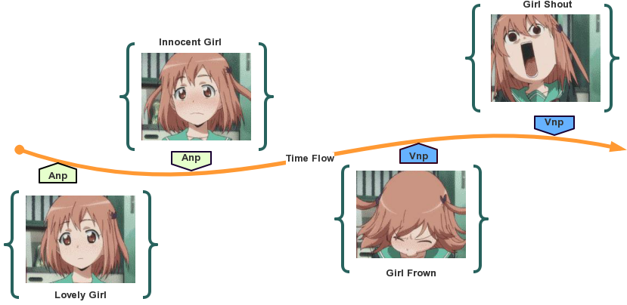
SentiPair and SentiPair Sequence
What made a good mid-level representation?
1. ANP is insufficient, we need Motion Descriptor (VNP)
SentiPair
Adjective Noun Pair (ANP)
Verb Noun Pair (VNP)
2. The order of ANP/VNP is important
1
3. Coverage must be concerned.
SentiPair Sequence
2
SentiPair Sequence is a sequence, SentiPairs are sorted in the order of their
appearance in the GIF video.
3
This work has been submitted to ACM’MM 2015 and is under peer review.

Slide 7
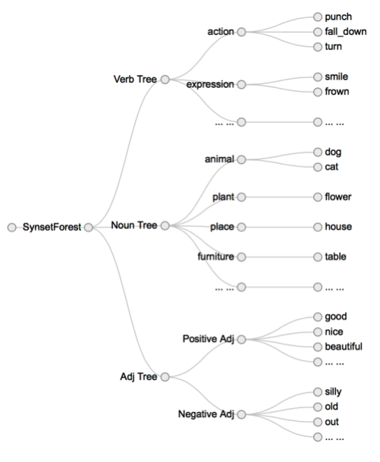
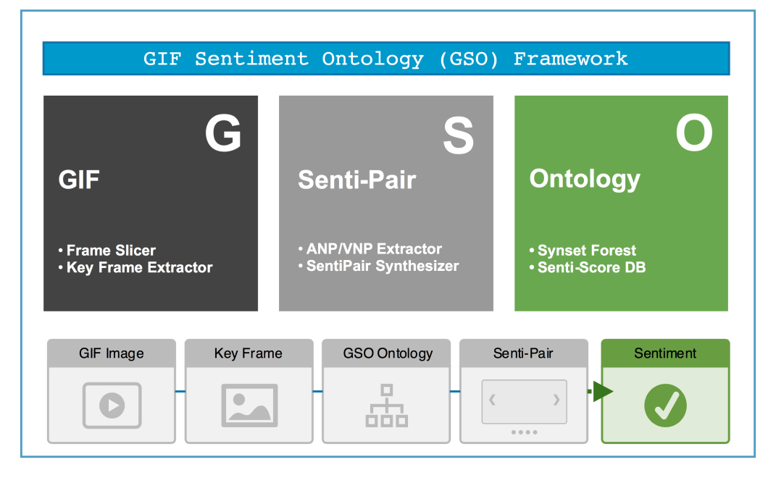
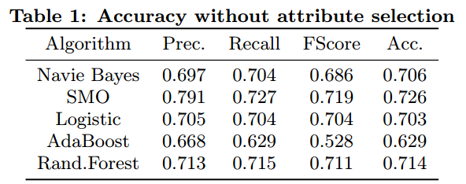
Ontology and GSO Framework
To solve the coverage problem, we introduced the GIF Sentiment Ontology.
Basic element were mined from the WordNet, with similar Synsets merged.
GSO Ontology
GSO Framework
An average of 70% accuracy
Benchmark
This work has been submitted to ACM’MM 2015 and is under peer review.

Slide 8
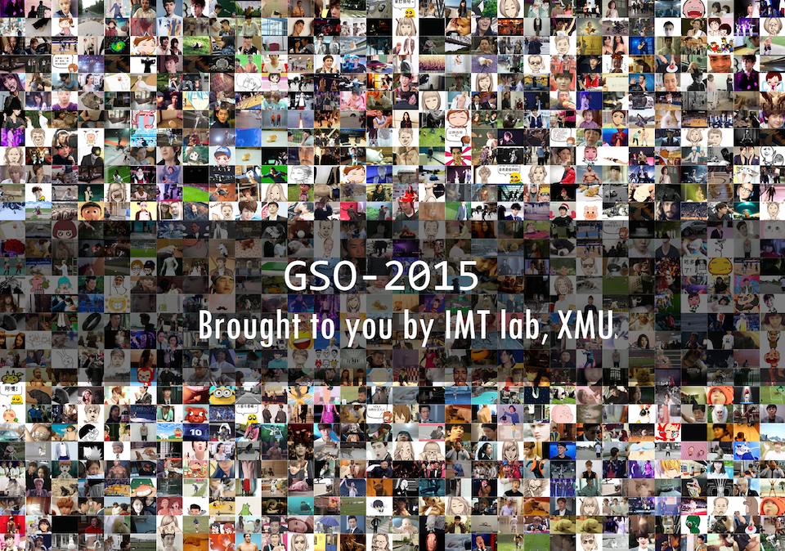
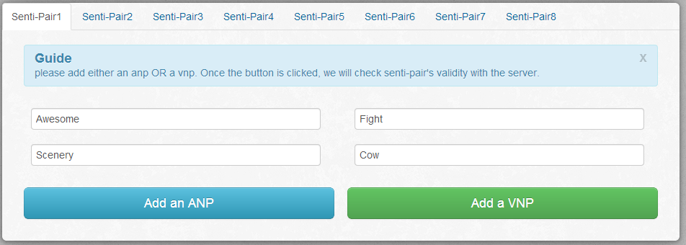
GSO-2015 Dataset and other Resources.
We also issued the GSO-2015 Dataset to the research community
GSO-2015 Dataset is a manually labeled GIF video collection.
It contains (for now) 1,902 GIF videos out of 40,041 candidates
Each GIF video is annotated with Sentiment and SentiPair Seq.
Further description and source code can be found on our website. You are very welcome to help us enlarge the GSO-2015 dataset by submit your annotation.
This work has been submitted to ACM’MM 2015 and is under peer review.

